Slide 1




Cab Capital Consulting
Our Team
Louie Labellarte
Tuhina Maji
Tommy Cleland
Jonas Hernando
ETL
Schema Design
Data Visualization
ETL
BI Queries
BI Queries
Data Visualization
Loading
BI Queries
Notes:
Jonas

Slide 2
Table of Contents
01
02
03
04
05
06
07
Introduction and Business Requirements
Tools and Data Requirements/Sources
ETL Methodologies
Data Warehouse and Star Schema
Business Intelligence Queries and Data Visualization with Tableau
Reflection
Appendix
Notes:
jonas

Slide 3
01
Introduction and Business Requirements
Notes:
jonas

Slide 4
Project Description
Project Scope
Cab Capital Consulting used robust data analytics and online analytical processing to help taxi cab drivers and companies optimize their ride logistics, identifying both periods of peak demand and popular NYC destinations to maximize operating revenue and lowering running costs
Our team has conducted analysis on approximately 12.2 million records of yellow taxi cab ride data from 2020-2023.
This project required:
Identification of business requirements
Individual data exploration
Divvying up of tasks
Scheduling of standing meetings and ad hoc meetings (as needed)
Setting deadlines for key project deliverables
Writing of ETL Python scripts
Agreed upon star schema
Setting up data warehouse in mySQL
Business intelligence queries
Data visualization platform integration using Tableau
Notes:
jonas

Slide 5

Project Objectives
Using OLAP operations, we aim to consult taxi drivers on maximizing profitability by identifying:
Zones of highest demand and during which times of the year
Factors affecting tip amount (sentiment analysis)
Zones that typically yield higher revenue during assumed periods of demand (i.e. the weekend)
TPEP vendor reliability in certain zones
Notes:
jonas

Slide 6
02
Tools and Data Requirements/Sources
Notes:
jonas

Slide 7




Software Tools
[1]
Extraction, Transformation, and Load
IDE: Jupyter Notebook
Language: Python
mySQL Integration
SQLAlchemy Python SQL toolkit
Data Warehousing
mySQL
Data Visualization
Tableau
[2]
[3]
[4]
Notes:
jonas

Slide 8
Source and Supporting Data
The primary source of data for this project is the NYC Trip & Limousine Commission (TLC) data for yellow taxi cab records:
We examined four years of data (2020-2023), with approximately 12.2 million total records
Raw data contained nineteen features pertaining to:
Trip date and duration
Starting and ending location
Base rate and associated surcharges and fees
Total ride cost with tip
Taxi cab computer vendor
Supporting data:
NYC Taxi Zones from NYC OpenData: Data maps the NYC Taxi Zones to the LocationIDs feature found in the raw taxi record data
USFederalHolidayCalendar import through Pandas library: Used to compare to the datetime features to determine if a taxi trip took place on a federal holiday
Yellow Trips Data Dictionary from the NYC TLC: Used to both understand the data as well as as to assign names to categorical columns (i.e. payment method, vendor name, rate name)
Notes:
jonas

Slide 9

New Dimensions
Measures
Categorical
trip_time_minutes: trip_dime.dt.total_seconds() / 60
fare_per_minute: fare_amount / trip_time_minutes
tip_per_minute: tip_amount / trip_time_minutes
tip_percentage: tip_amount / total_amount
avg_mph: trip_distance / (trip_time_minutes / 60)
pickup_zone
pickup_borough
dropoff_zone
dropoff_borough
vendor_name
rate_code_name
payment_type_name
day_of_week: Utilized dayofweek function
Is Holiday: Import USFederalHolidayCalendar library through Pandas
Notes:
Louie

Slide 10
03
ETL Methodologies
Notes:
Louie

Slide 11

Extract
Transform
Python used to extract the months and years of data; Scripts able to load the parquet file directly from the source website
10% of each month’s data extracted from the source, before being cleaned, transformed, and loaded into the mySQL database
Cleaning with Python
Dropped records that:
Contained negative values for trip distance, trip time, and fare amount
Had trip years other than 2020-2023
Contained NaN
‘0’ trip distance
Did not meet the other data constrictions per the data dictionary
Contrived features:
Average MPH
Fare per Minute
Tip per Minute
Tip Percentage
Total Features: 42
Notes:
Louie

Slide 12
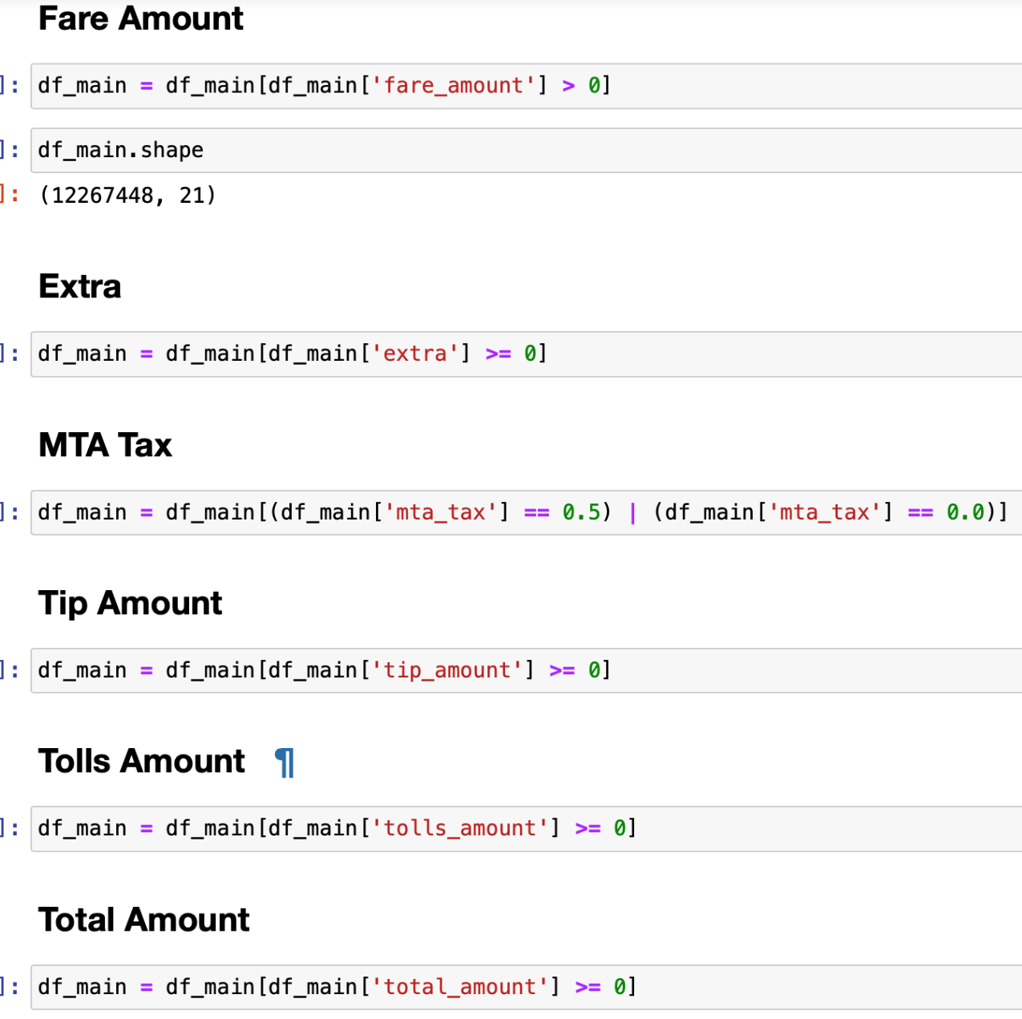
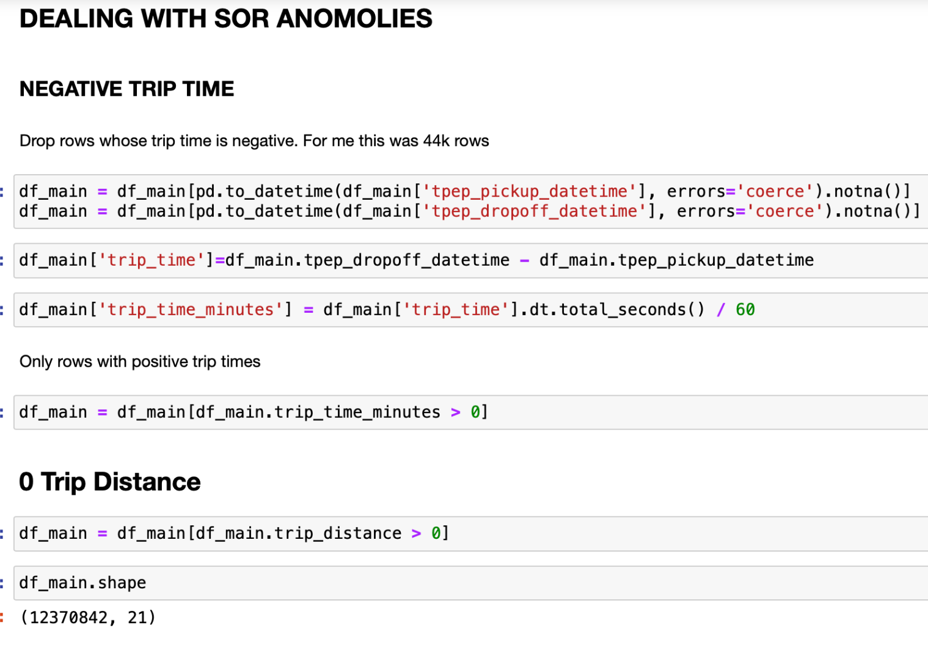
Cleaning Scripts
Notes:
Louie

Slide 13
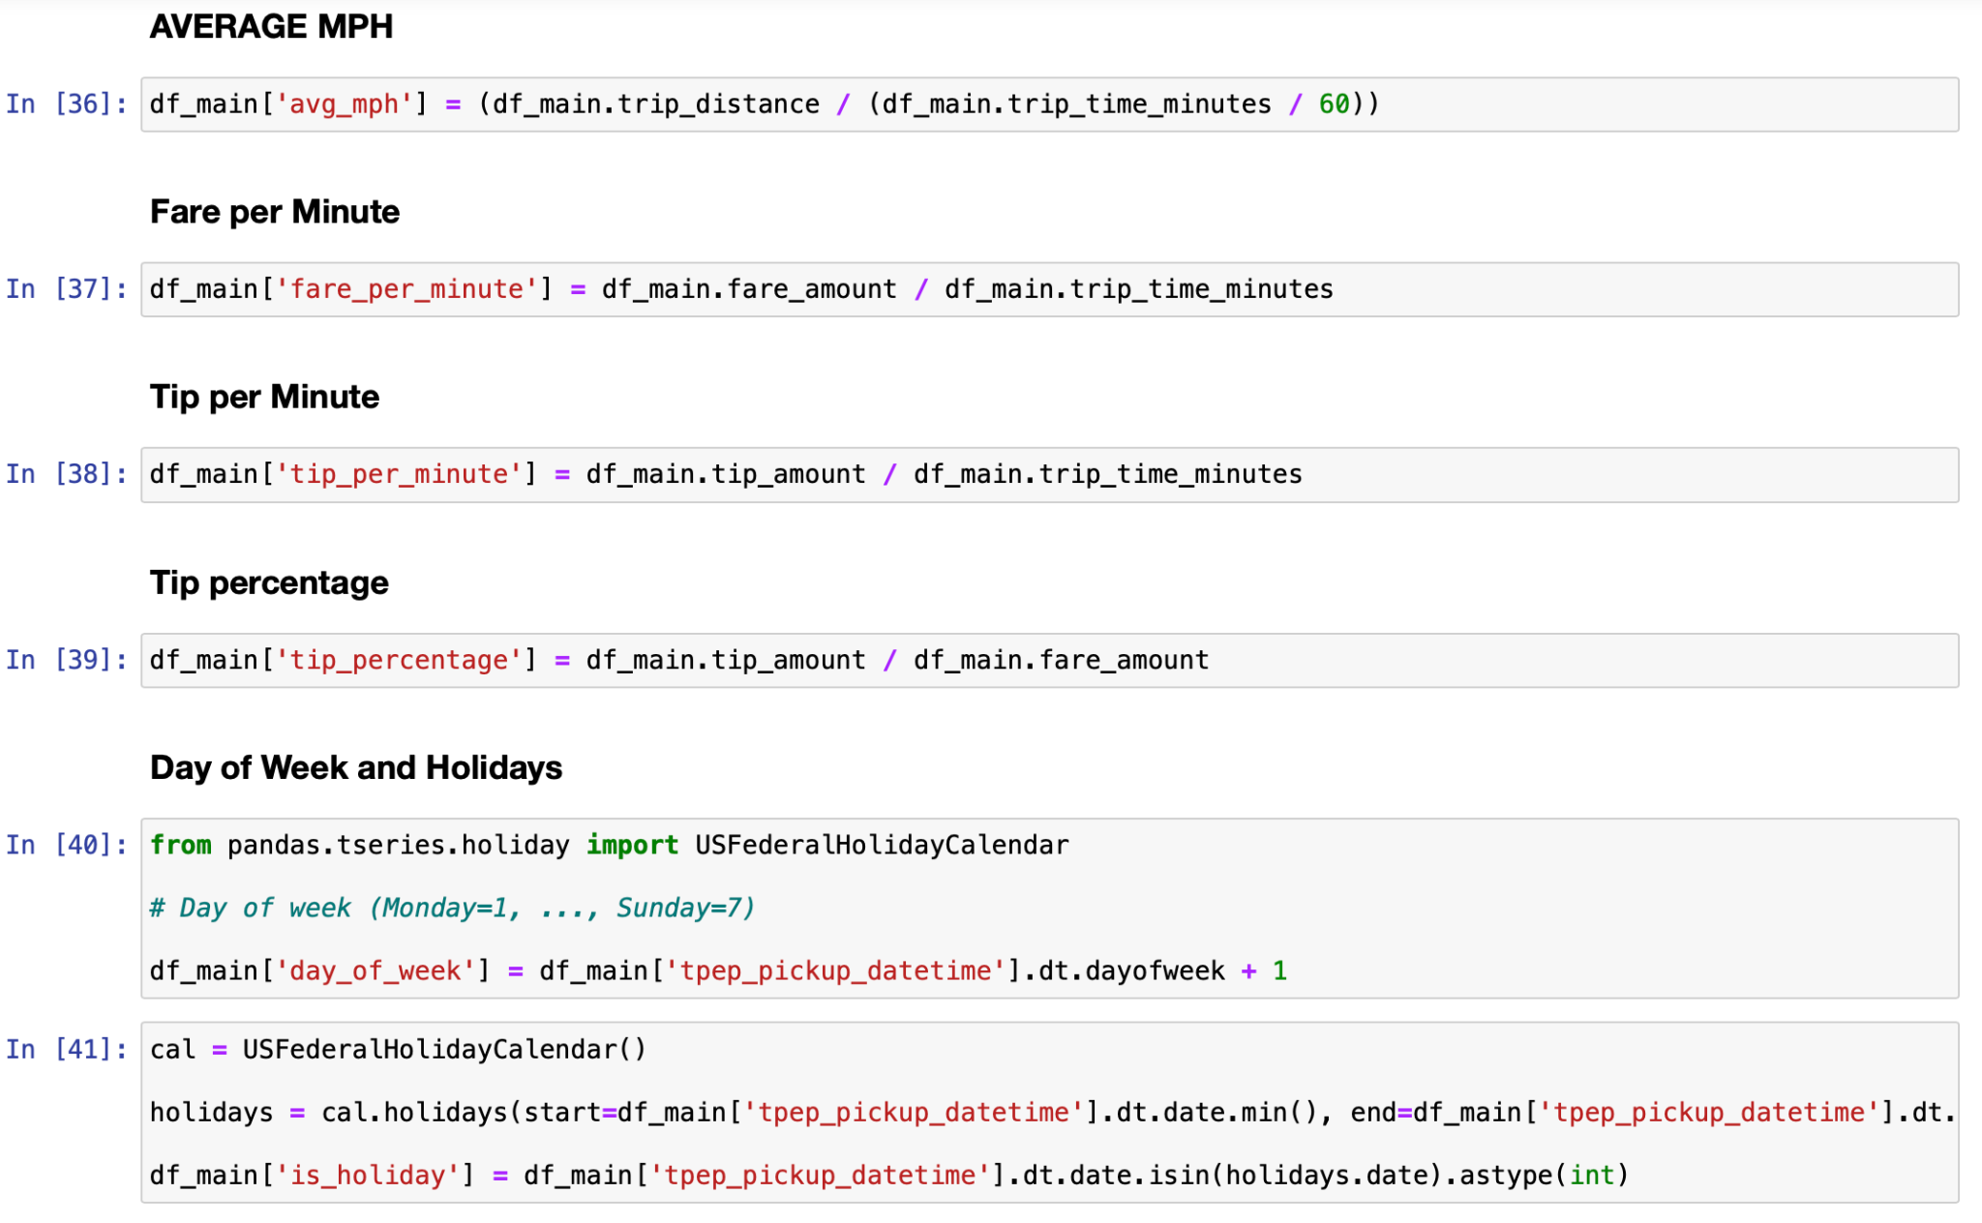
New Dimensions Script
Notes:
Louie

Slide 14
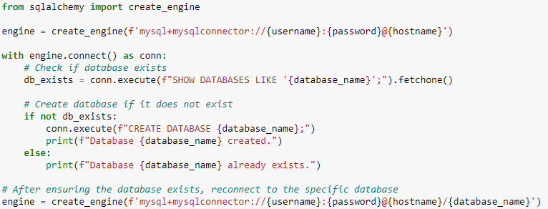

Load
Incremental Update to Star Schema
The SQLAlchemy toolkit was used to connect to mySQL to load the transformed data in batches of 1,000 records
If the star schema ever needs to be updated, the database manager is designated to initiate the change request. This will be done manually/without automated scripts
Notes:
Tuhina

Slide 15
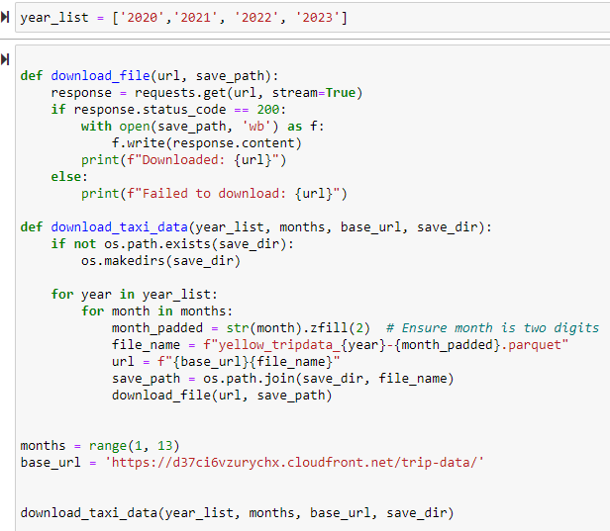
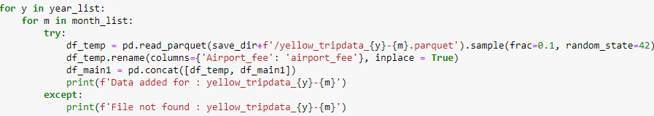
Incremental Update of the Data Warehouse
Notes:
Tuhina

Slide 16
04
Data Warehouse and Star Schema

Slide 17

Data Warehouse Creation
Data warehouse was created in the mySQL environment for benefits of:
Open-source software
Widely adopted and straightforward to implement, use, and maintain
High level of performance even with large volume of data
Loaded the 12.2 million records into a single source table to start, and conducted simple queries to validate that the data loaded correctly
First created the dimension tables, then the fact table before inserting the data from the source table
Had to modify the insertion query as inserting the vendor information resulted in the number of records in fact table doubling to 24.4 million
Timeout issues when inserting into the fact table
Notes:
Tommy

Slide 18
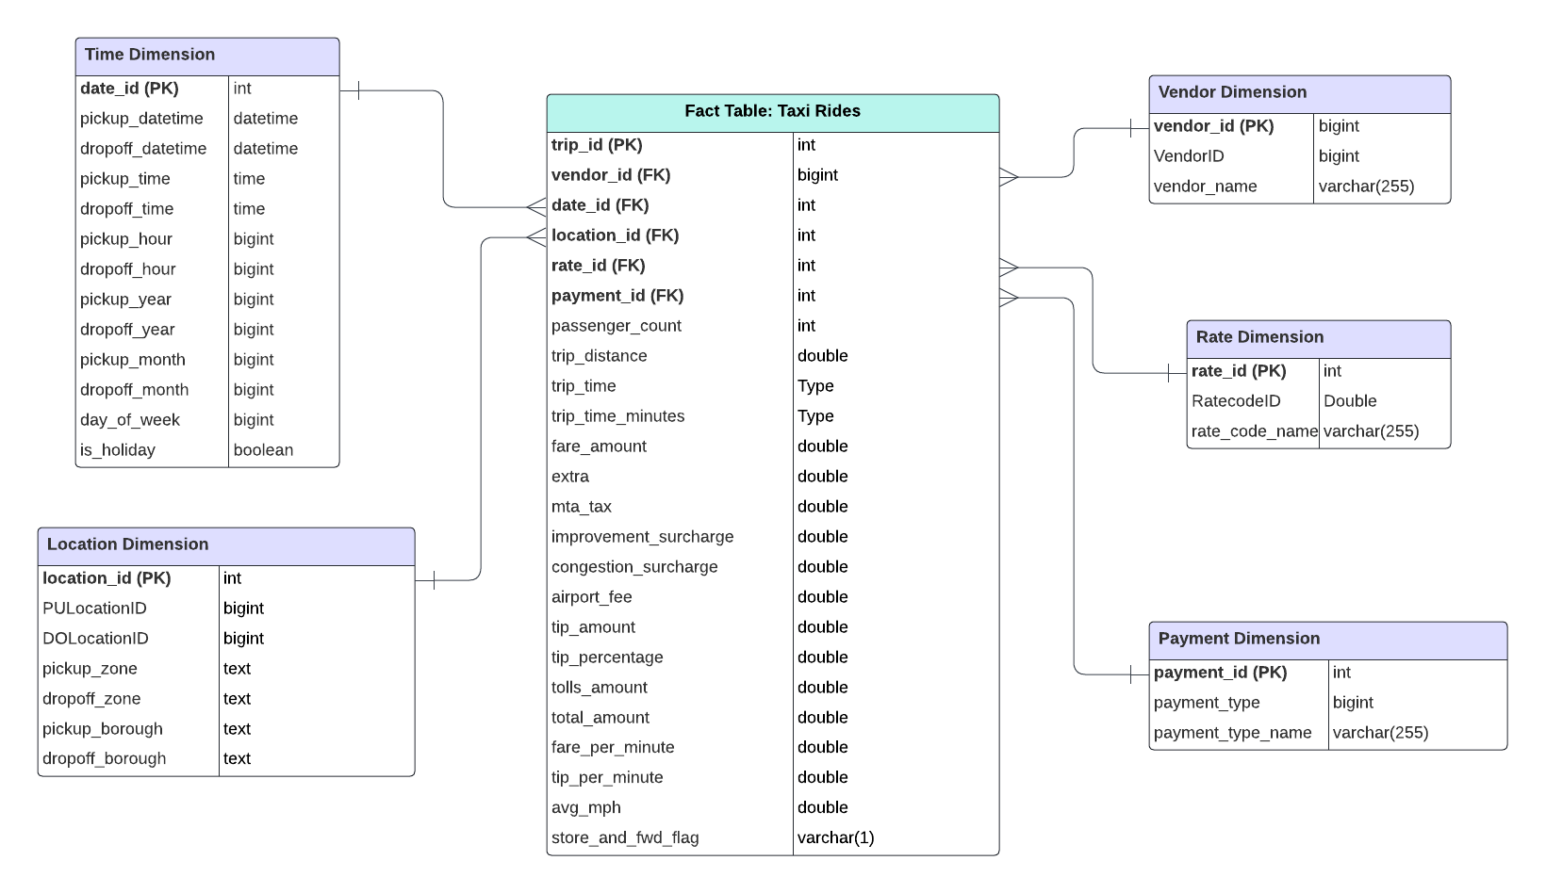
Star Schema
Generated using Lucid Charts
Notes:
Tommy
Time Dimension:
Location Dimension:
The following dimensions have very specific use cases
Vendor Dimension:
Rate Dimension:
Payment Dimension:
They are important to accomplish our goals, but not related to each other enough to justify grouping them. Keeping them as dimension tables also saves storage as opposed to keeping the information in the Fact Table.
CHECK TUHINAS NOTES IN THE PROJECT DOCUMENT

Slide 19
05
Business Intelligence Queries and Data Visualization with Tableau

Slide 20
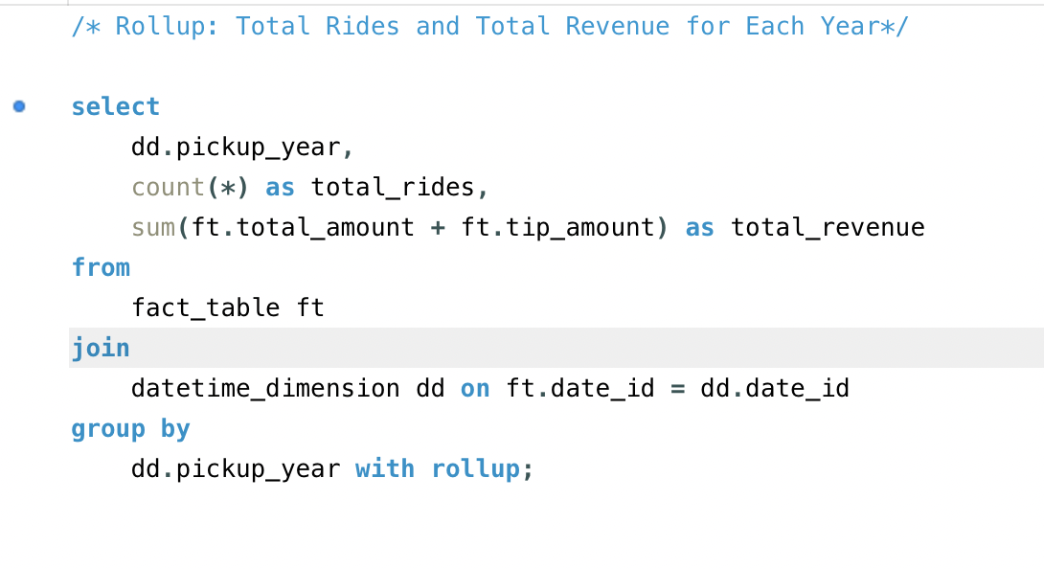
Rollup Operation: Total Rides and Total Revenue by Year
Goal: Provide summary output of total rides and revenue generated for the four years of analysis
Will help taxi cab companies see a high-level look at operations for these four years, and see any trends (i.e. revenue in 2020 dipped, presumably to Covid shutdown)
Forecast for future revenue trends, and tune operations to reduce operating costs to increase net income
pickup_year | total_rides | total_revenue
2020 | 2344433 | 47249857.55970810
2021 | 2890725 | 62097075.20932570
2022 | 3745050 | 90563045.65791920
2023 | 3290168 | 106660227.7698370
NULL | 12270376 | 306570206.20409800
Notes:
Jonas

Slide 21
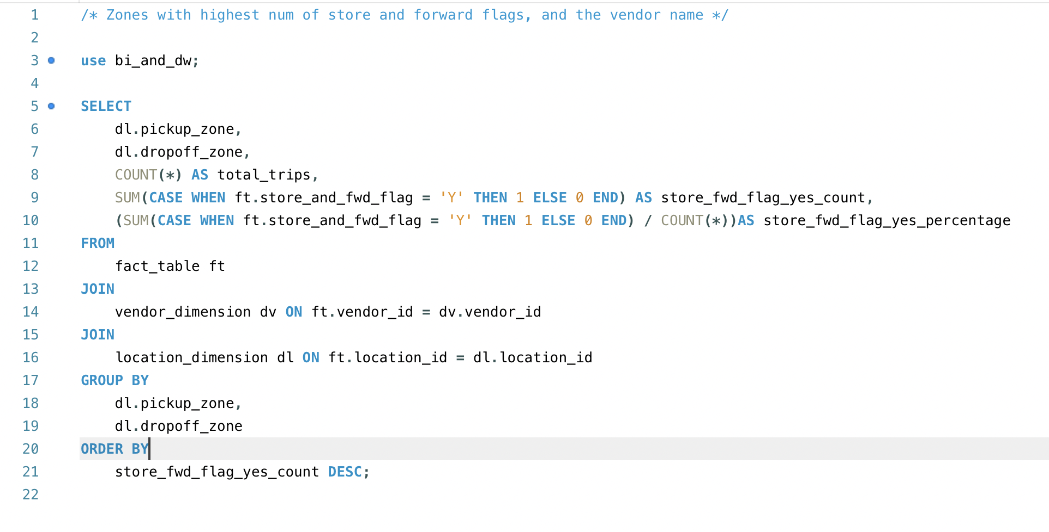
Store and Forward Analysis
Goal: Identify both the pickup and dropoff zones that showed the highest average percentage of cases where the ride had a store and forward flag
Will help drivers and companies know when to expect connection losses when operating in certain zones
Even though credit card payments are the most prevalent method of payment, the driver can offer alternative payment options to the customer if they are wary about connection issues
Notes:
Cases mainly seen in Harlem and Upper East Side North/South, though this is expected since those locations in Upper Manhattan have higher volumes of rides overall

Slide 22
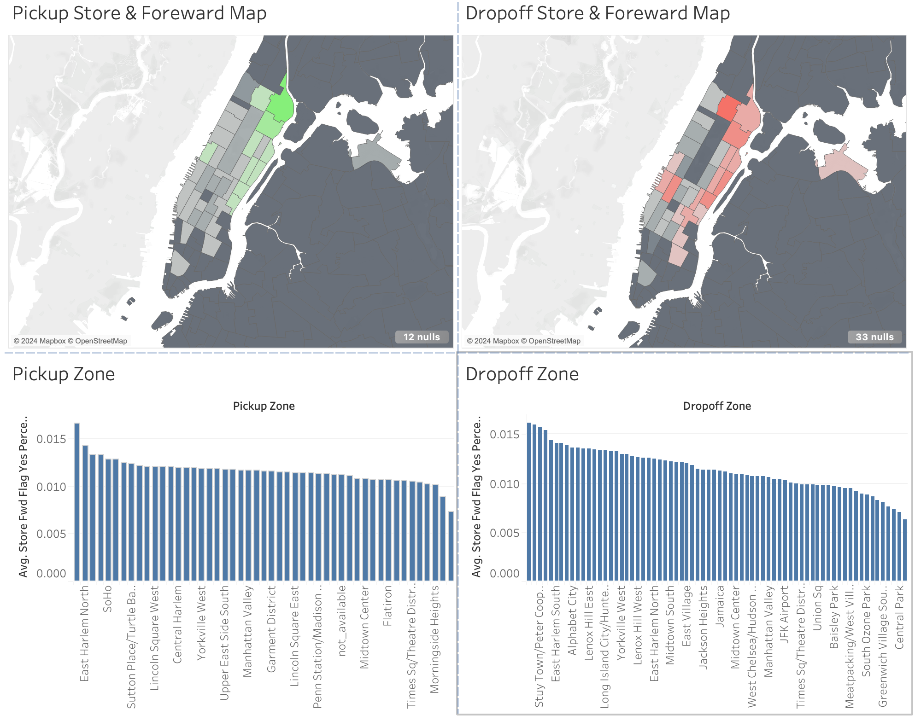
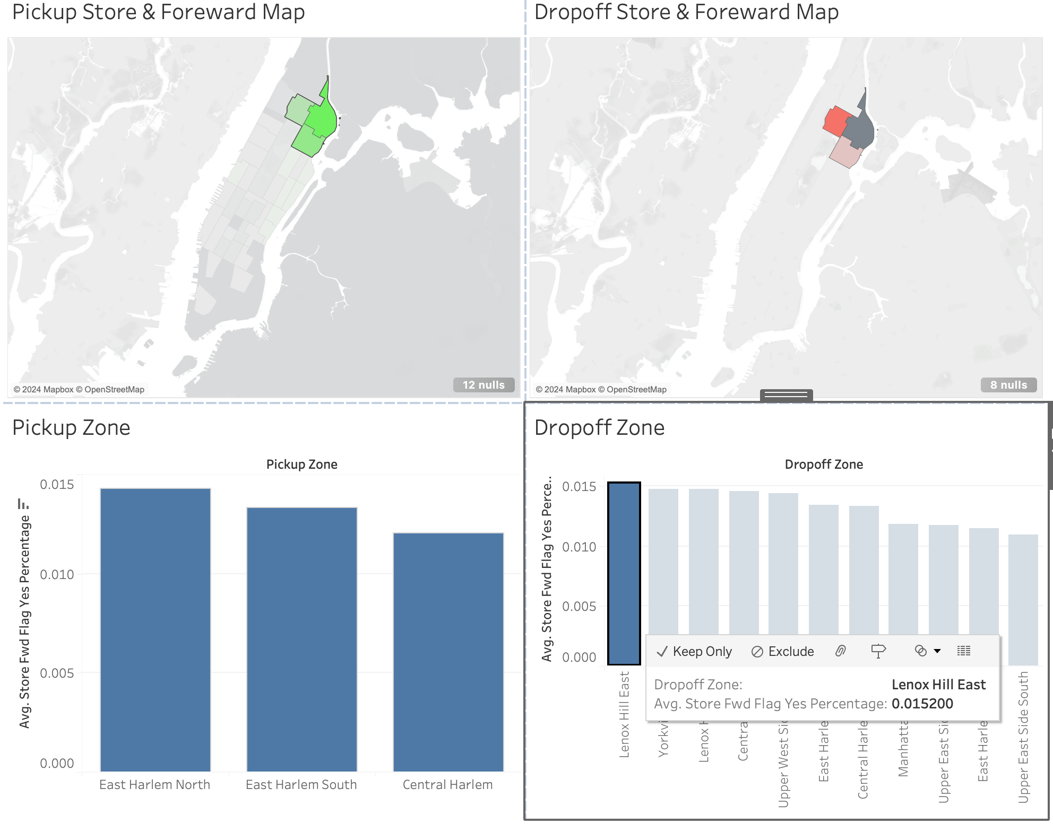
Store & Forward Analysis
Notes:
Illustrates the the connection between pick up and drop off zone relative to store and forward percentage. Select a pickup zone, and the rest of the dashboard filters to show the related drop off zones with their respective store and forward percentages. This helps us to identify zones where network issues are common for the purpose of infrastructure advocacy.
Jonas/Louie

Slide 23
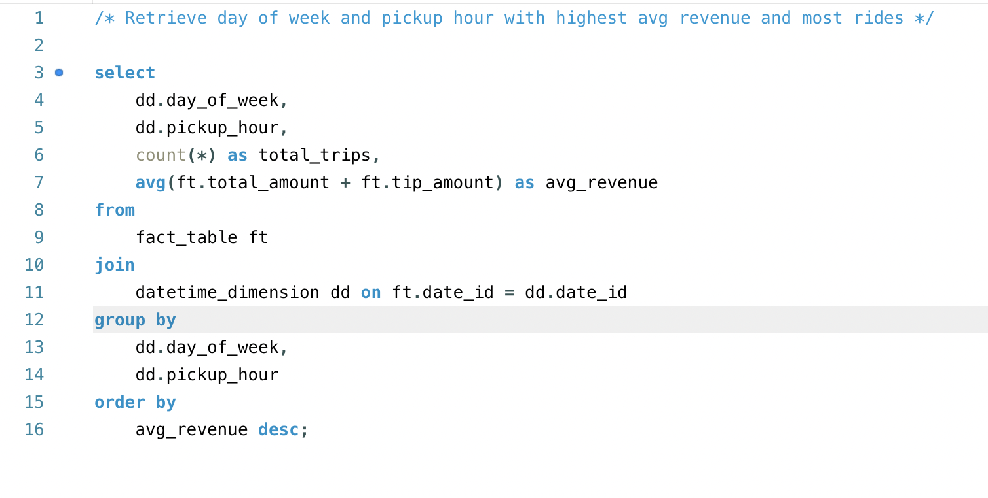
Day & Hour Average Revenue & Trips
Goal: Identify which hours of each day of the week have the highest demand and highest average revenue
Will help drivers and companies be strategic in when during the week they take rides; operate during hours in which there is low demand but higher average cost for the ride
Reduce operating costs by using the vehicle less, but at the same time increasing revenue
Notes:
Findings: Early mornings had the highest avg revenue per trip, usually in the beginning and end of the week (Saturday, Sunday, Monday), but those days actually had fewer trips overall when compared to the rest of the week; may be driving due to work and therefore collecting a higher base fare and more surcharges

Slide 24
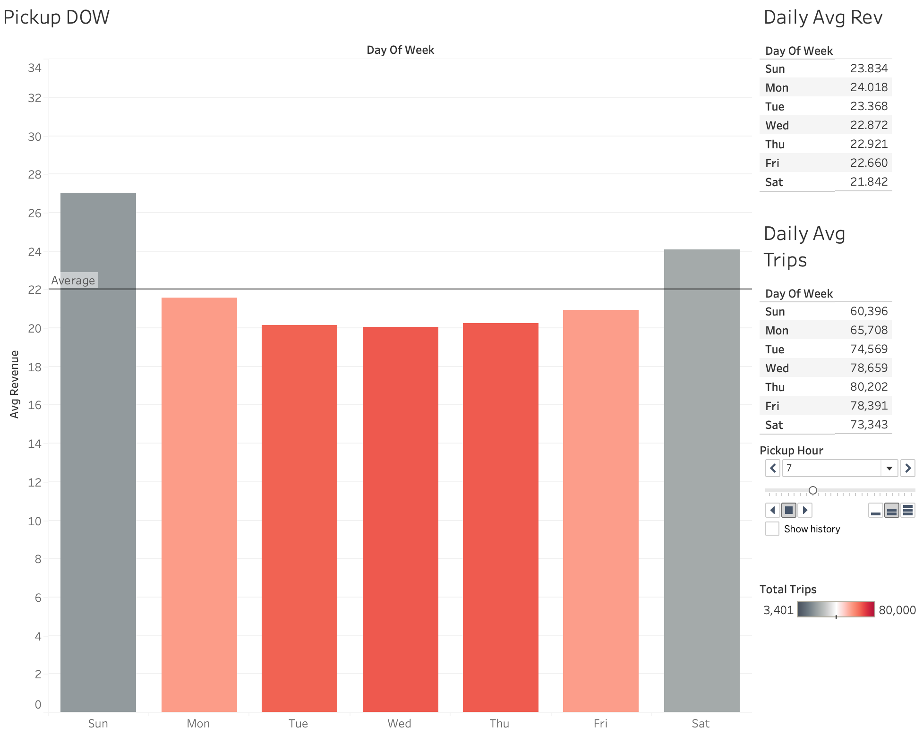
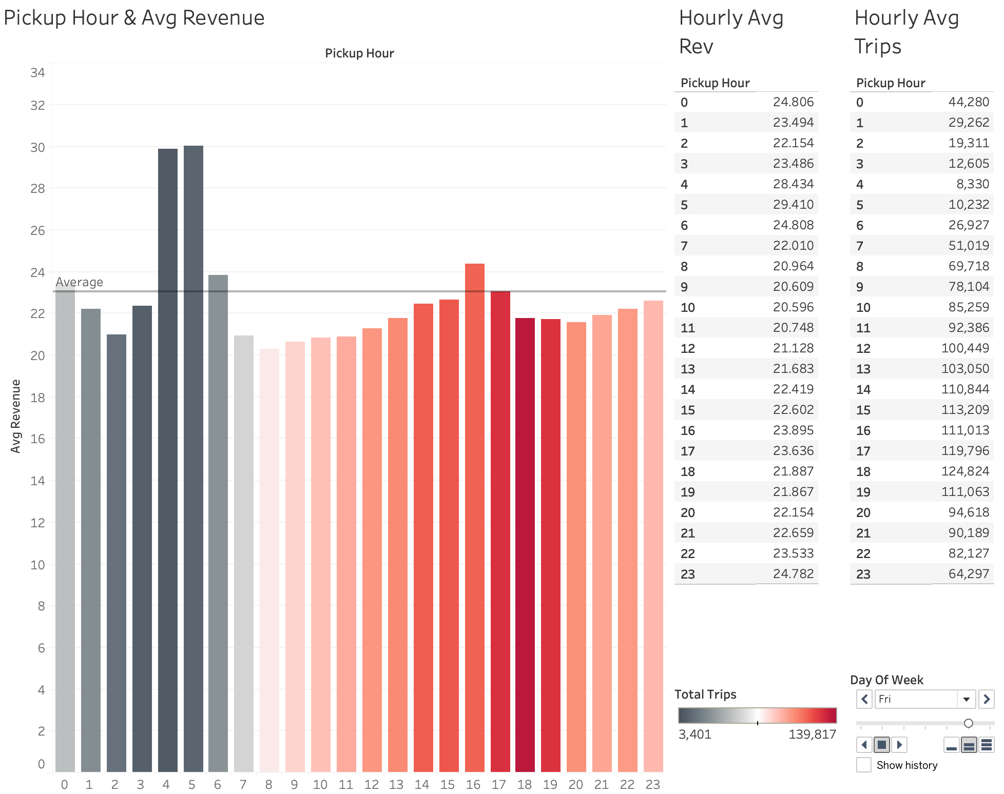
Day & Hour Average Revenue & Trips
Notes:
This pair of graphics depicts average revenue by colored by average trip count. The first graphic shows days of week per hour, and the second graphic shows hours of the day per day of week. These graphics help us find times of day with low demand and above average fare.
Jonas/Louie

Slide 25
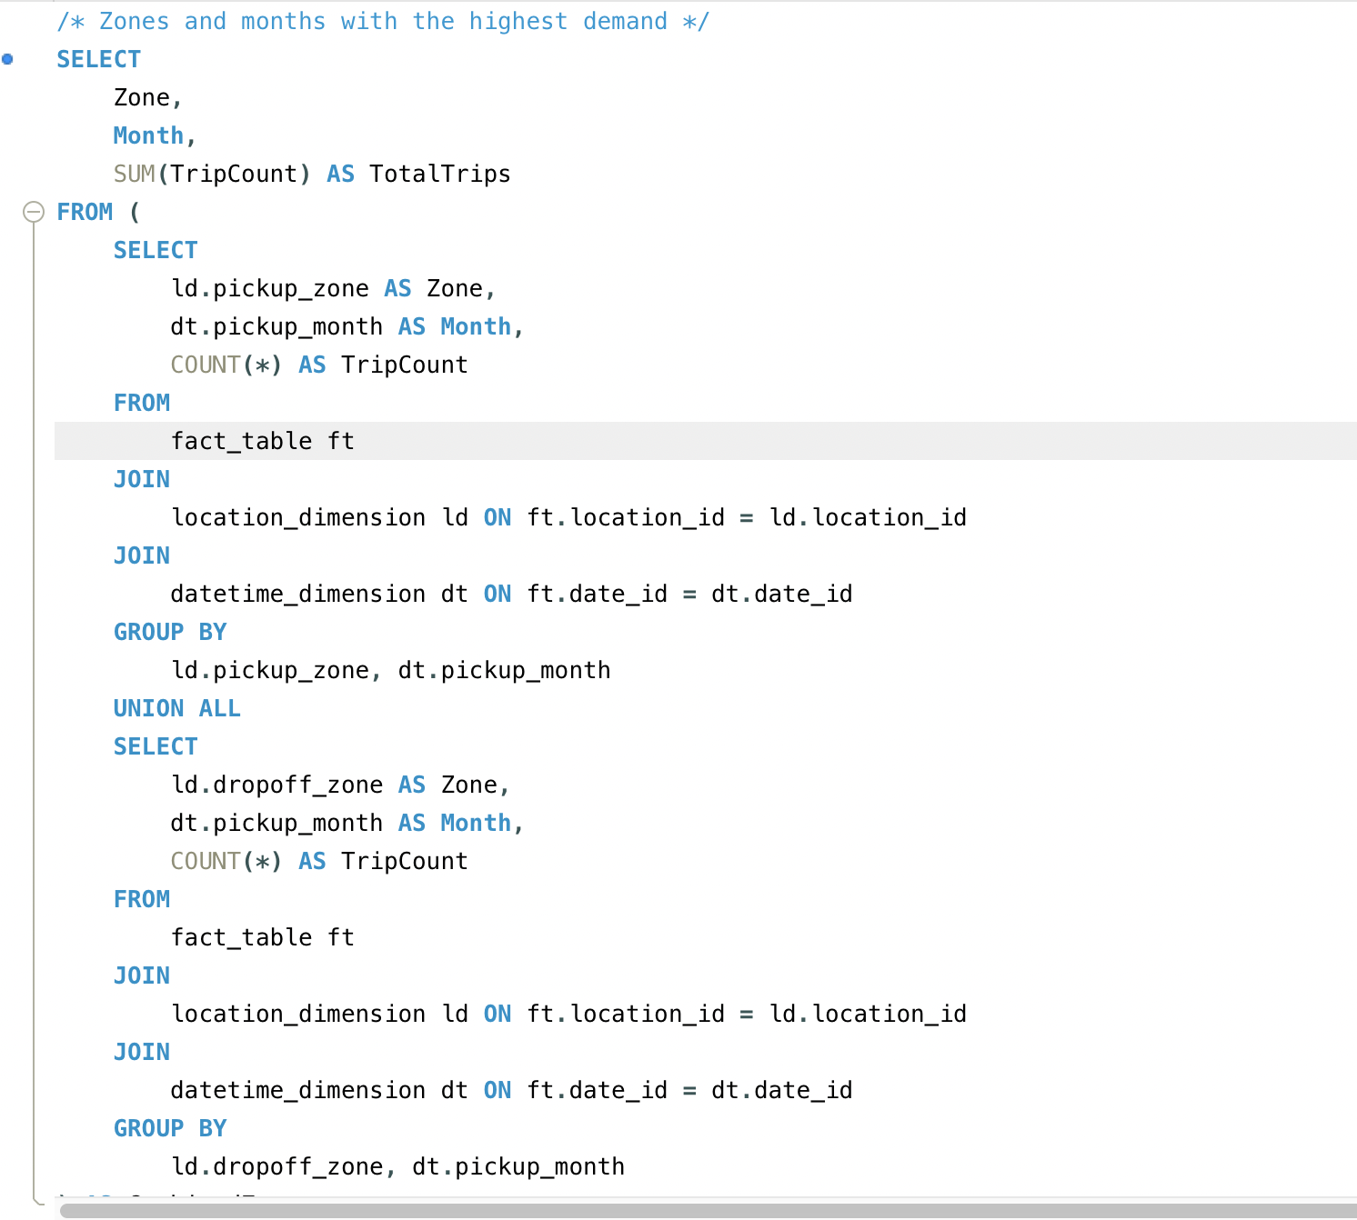
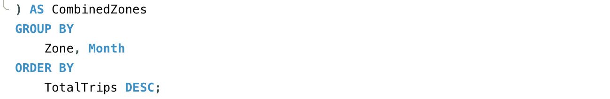
Highest Demand
Goal: Identify zones of highest demand during each month, taking total trips
Gives drivers high-level view of volume in all possible zones of operations, allowing them to make such decision as:
Take rides during periods of high demand
Take rides during periods of low supply, but potentially higher revenue collection
Notes:
Manhattan zones had higher demand across all months

Slide 26
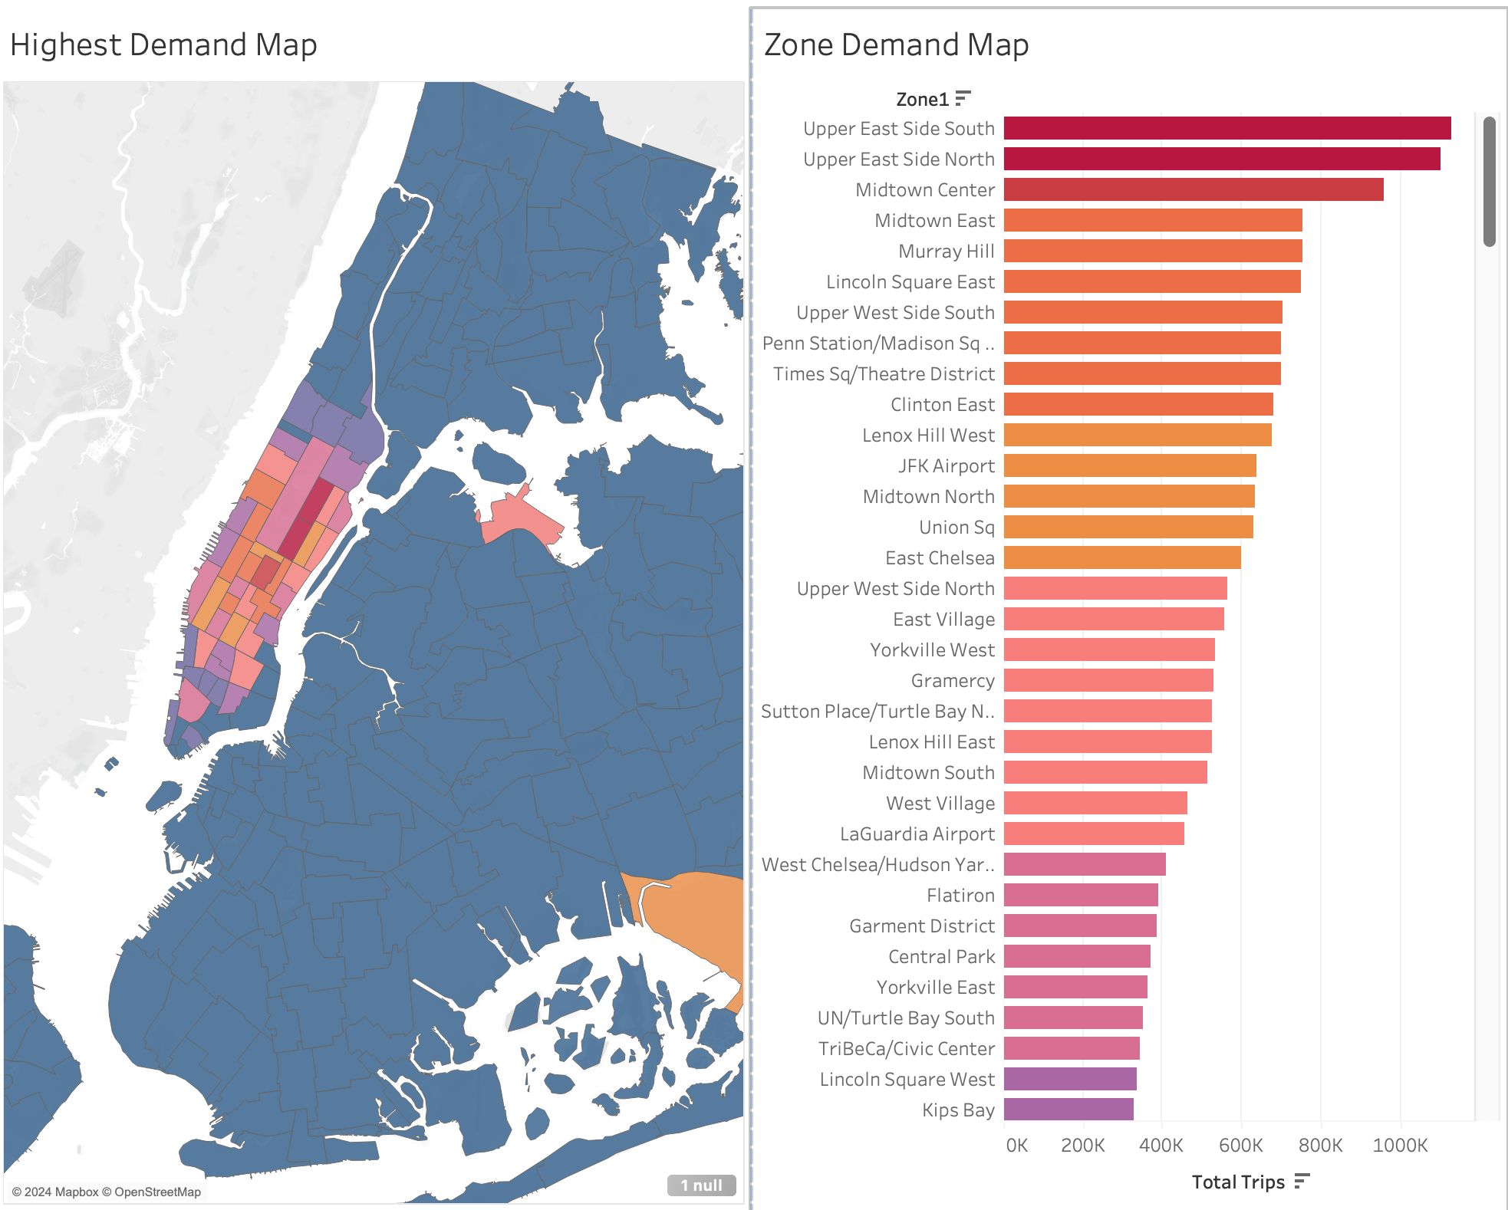
Highest Demand Guide
Notes:
This is a static map used to highlight the zones of highest demand by total trip count (including pickup and dropoff). We could distribute this map to our customers to help them find consistent work, or find higher fare in areas with less supply.
Jonas/Louie

Slide 27
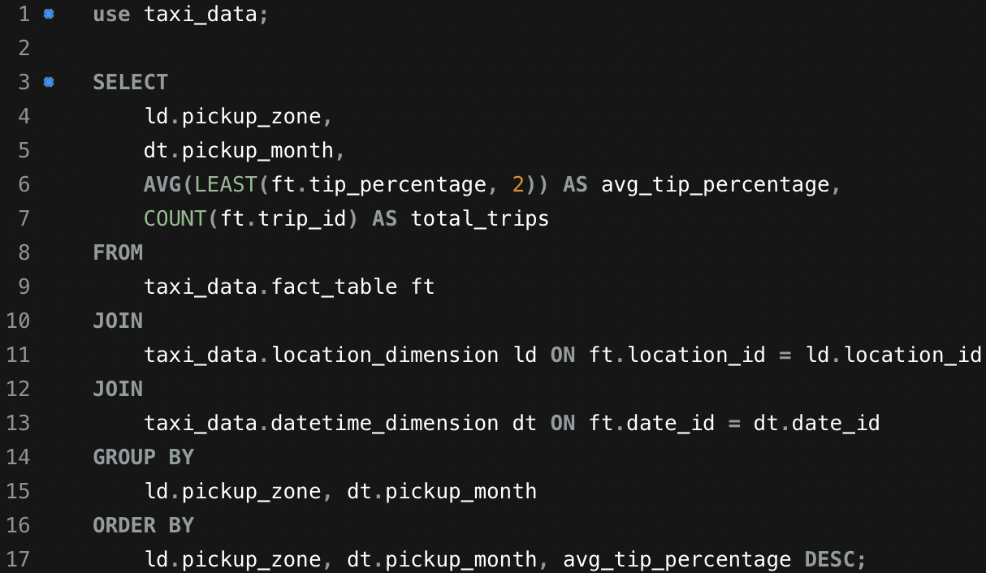
Average Tip Percentage by Month
Goal: Identify zones on the basis of monthly average tip percentage and trip demand. Average excludes outliers greater than 200%
Gives drivers an idea of average tip rates per zone, level of demand, and associated seasonality allowing them to make such decision as:
Identify zones with consistently high tip percentage
Identify seasonal and geographic opportunities for high tip percentages
Notes:
Manhattan has higher trip volume, most likely because they have more trips out of the other boroughs overal

Slide 28
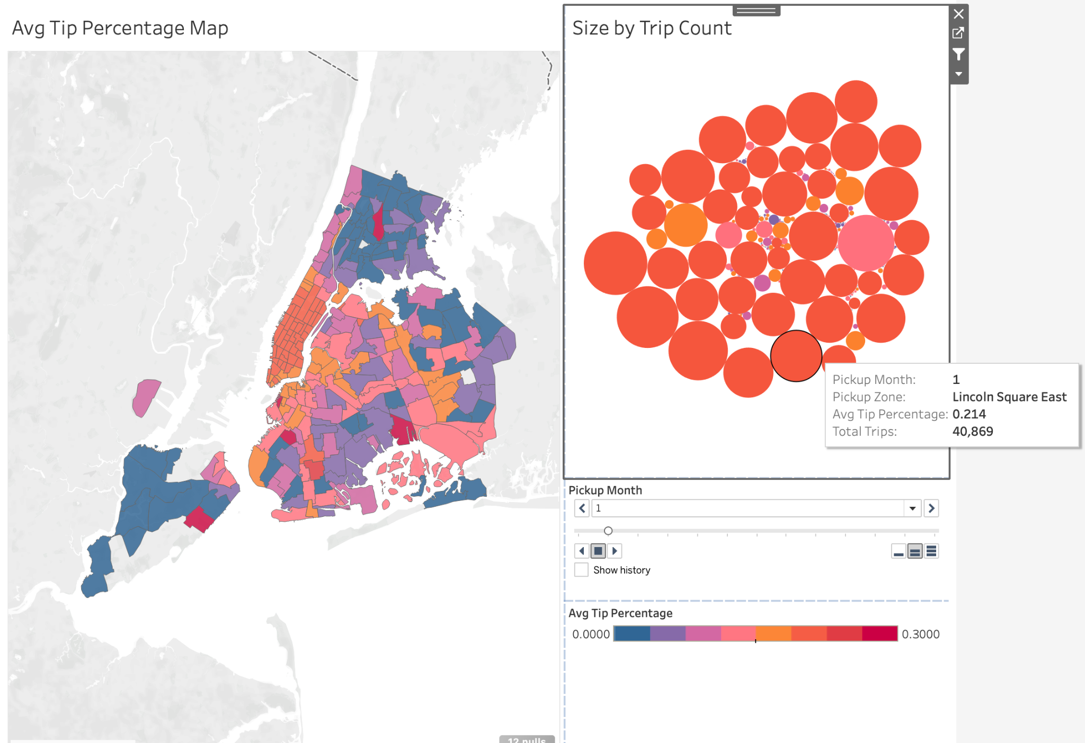
Average Tip Percentage by Month
Notes:
This map depicts the seasonality of average tip percentage by zone
Jonas/Louie

Slide 29
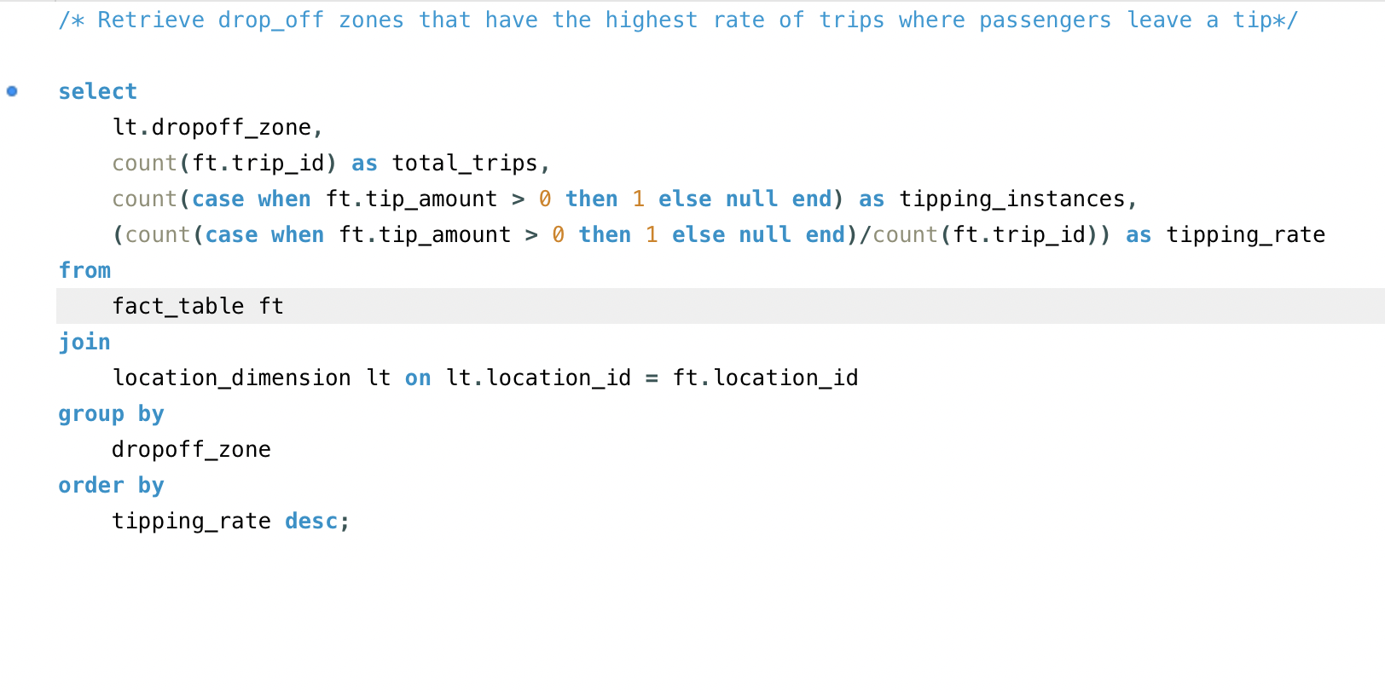
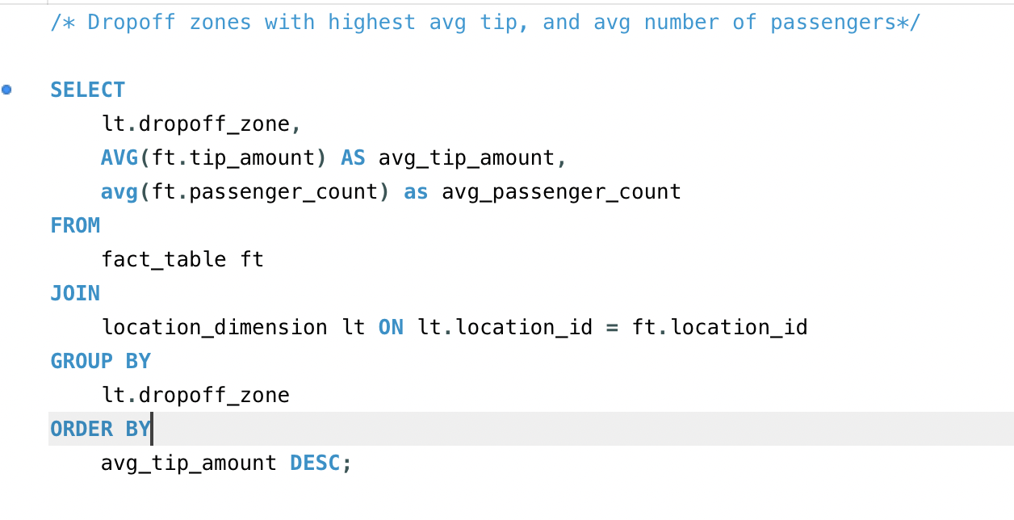
Tipping Rate vs. Tip Amount
Goal: Retrieve dropoff zones that show both highest tipping rate, and highest average tip
Needed to be mindful of outliers, as some routes had single trips that had large tip amounts
Taxi driver and companies can work routes in which a passenger is more likely to leave a tip, and tune further by taking trips on those routes given the passenger count
Notes:
Tommy

Slide 30
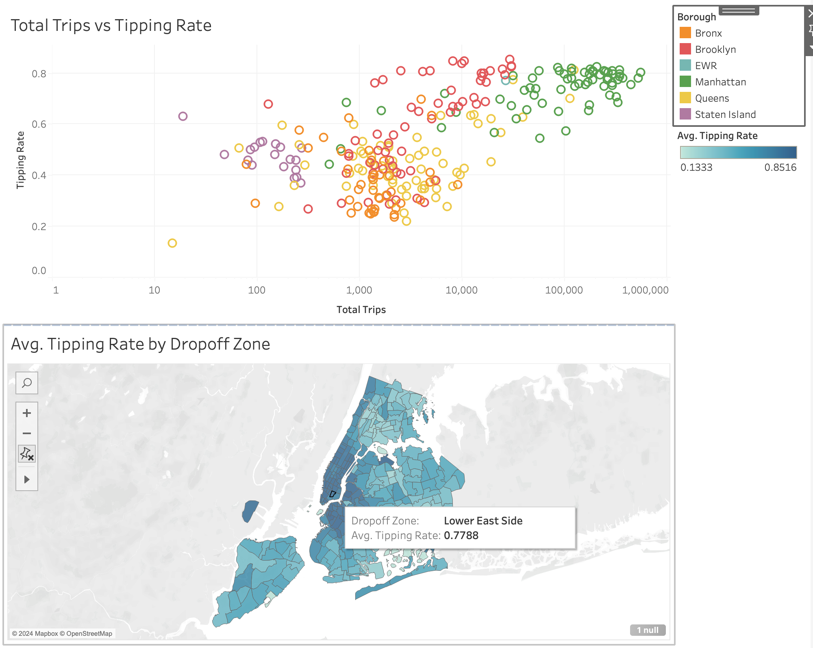
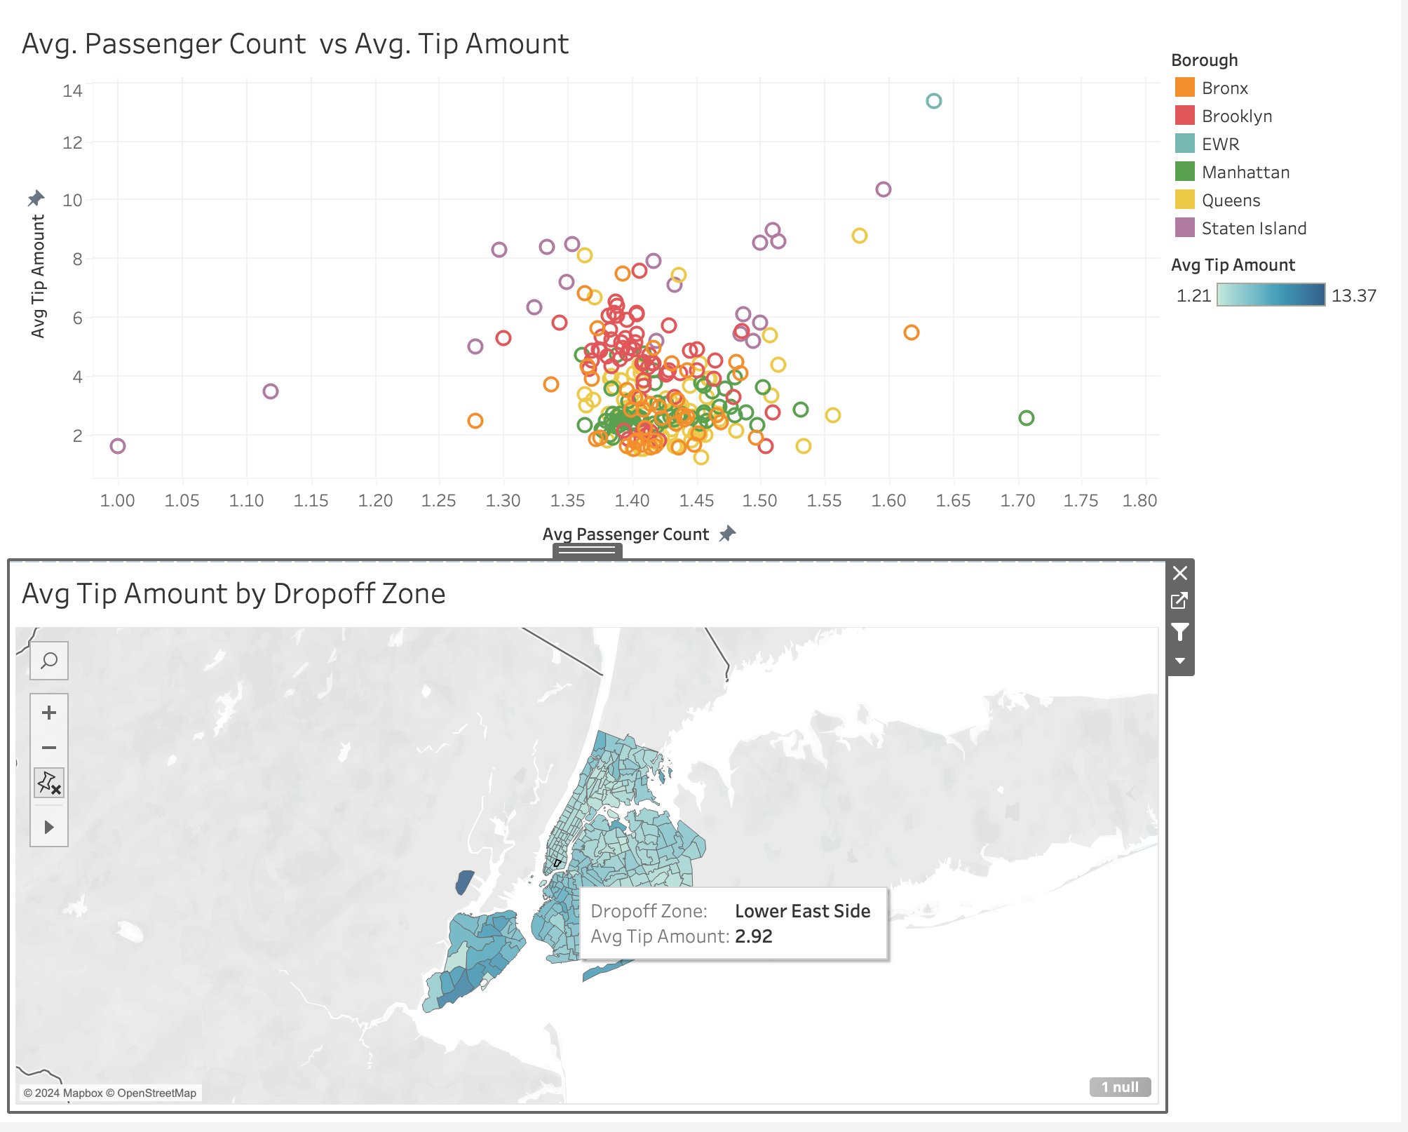
Tipping Rate vs Tip Amount
Notes:
Tommy’s Query

Slide 31

Impact on End Users
The Target Audience
The Impact
Our target customer base will be the taxi cab companies and their taxi drivers looking to optimize their revenue collection by helping to identify popular pickup and dropoff locations, as well hours of peak demand.
The advent of rideshare services such as Uber and Lyft have reduced the value of the taxi cab medallion and the demand for taxi rides overall [5]
With our BI tools, taxi cab companies and their drivers can maximize revenue generation by:
Being in service during periods and in zones of high demand
Accepting trips on routes that typically result in tips
For the driver: Offset the cost of the vehicle lease and yield higher take-home pay
For the cab company: Lower the cost of operations by having less wear-and-tear on the vehicle
Notes:
Tommy

Slide 32

Thank you!
Any questions?
Notes:
Tuhina

Slide 33
07
Appendix
Notes:
Louie

Slide 34
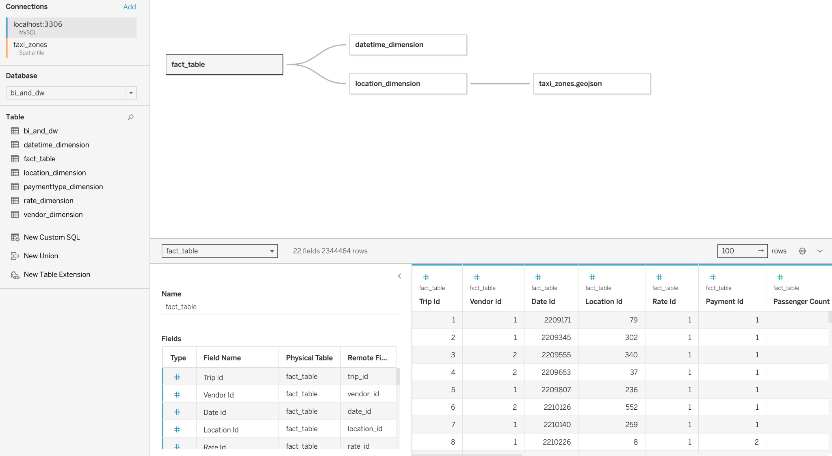
Data Source
​​
Notes:
Louie

Slide 35
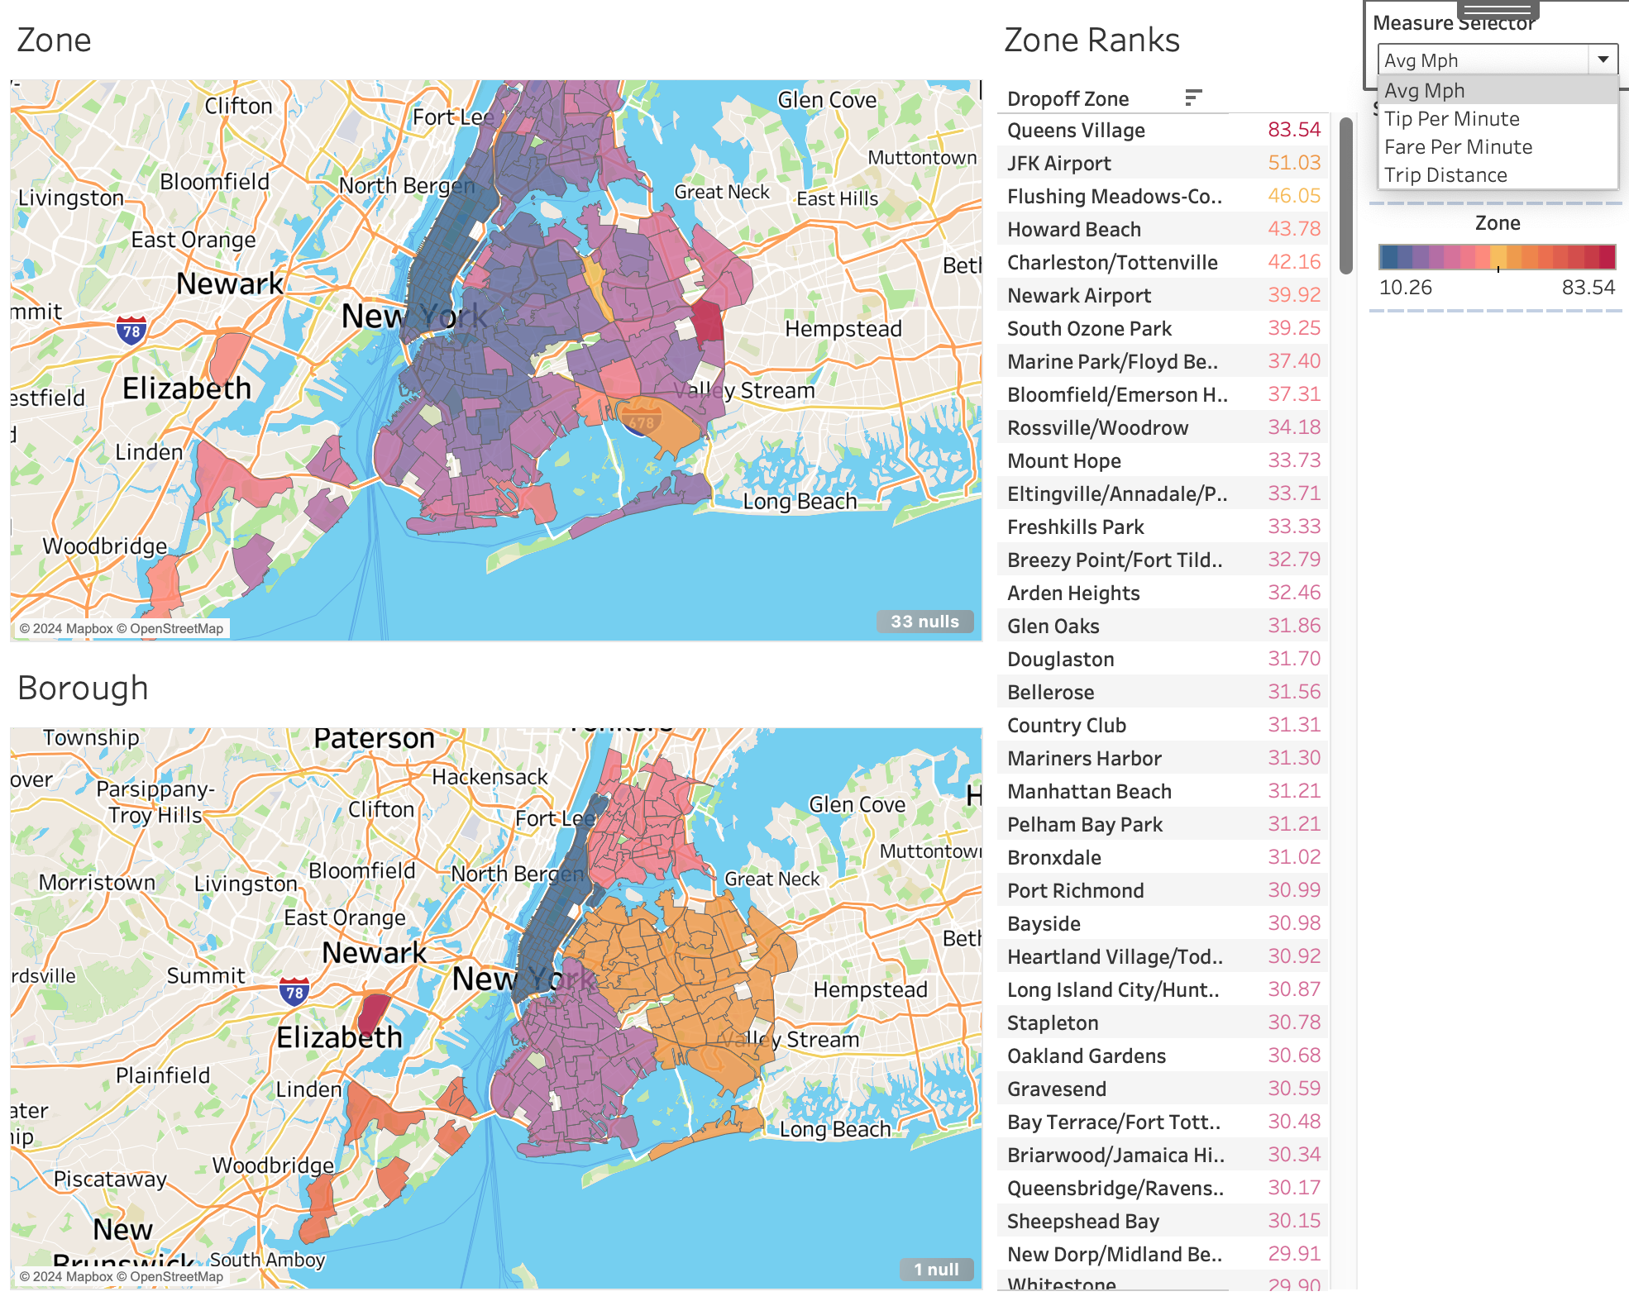
Notes:
Louie

Slide 36
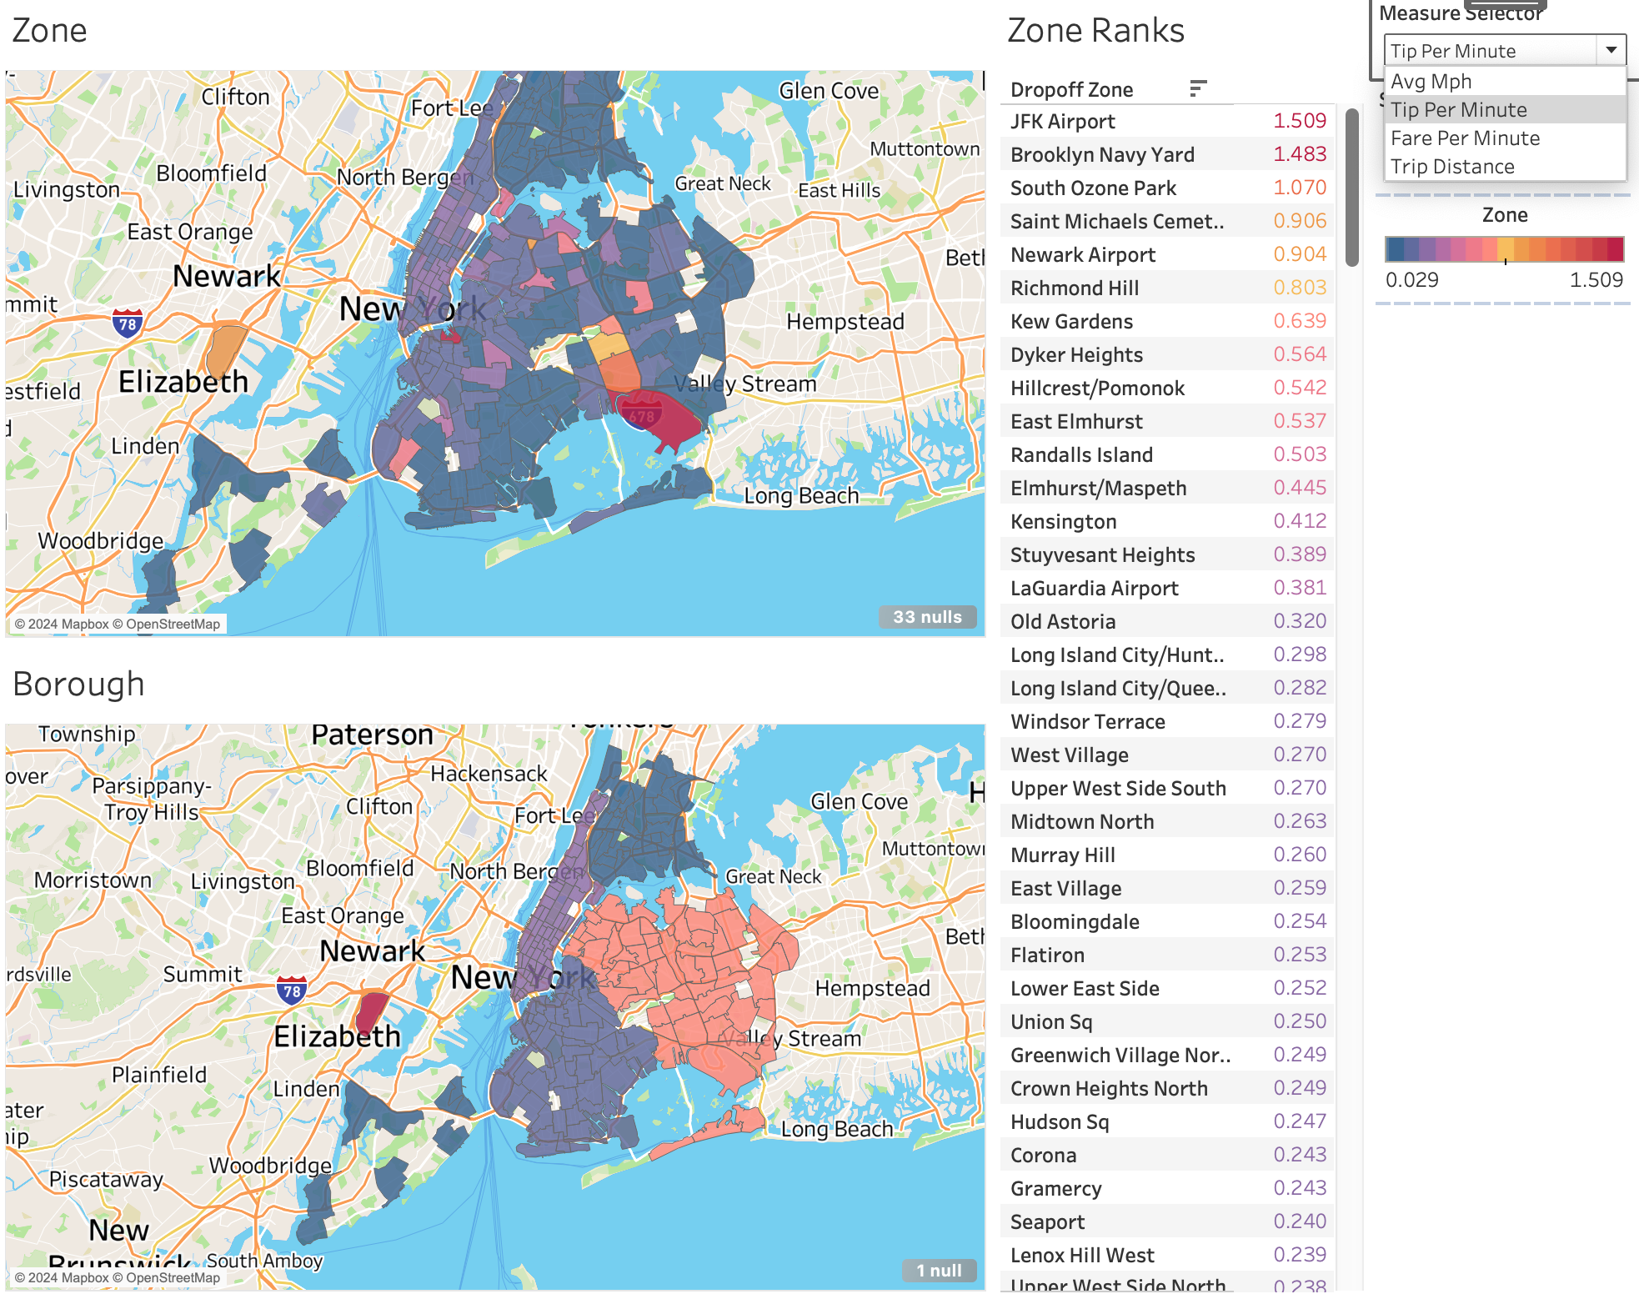
Notes:
Louie

Slide 37
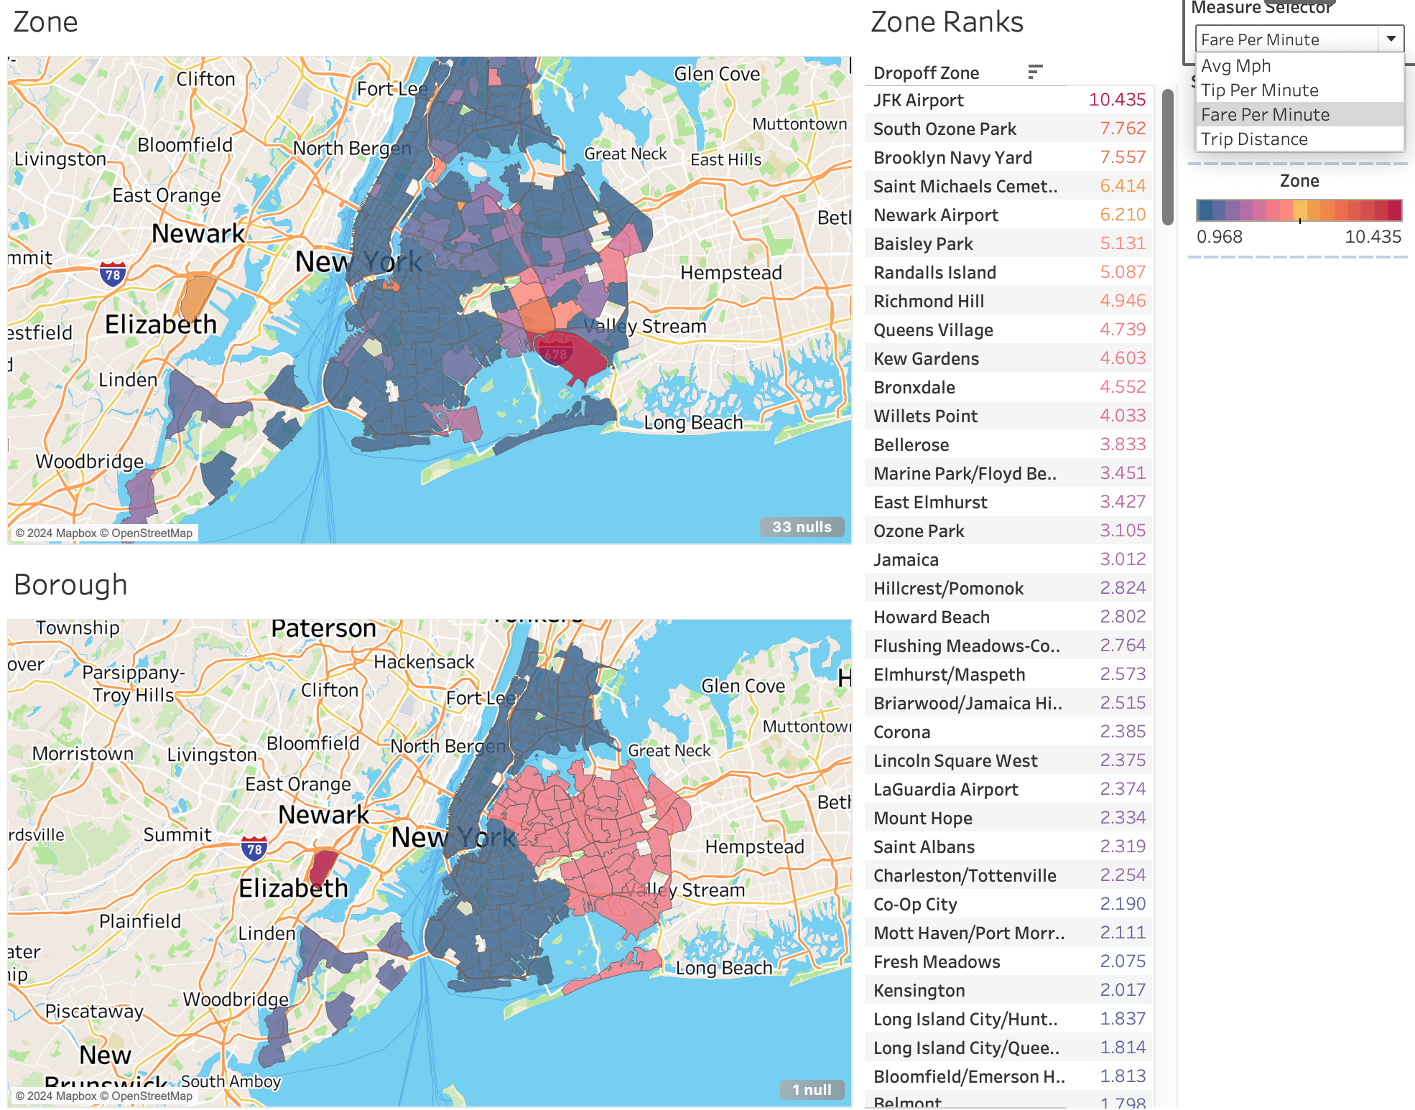
Notes:
Louie

Slide 38
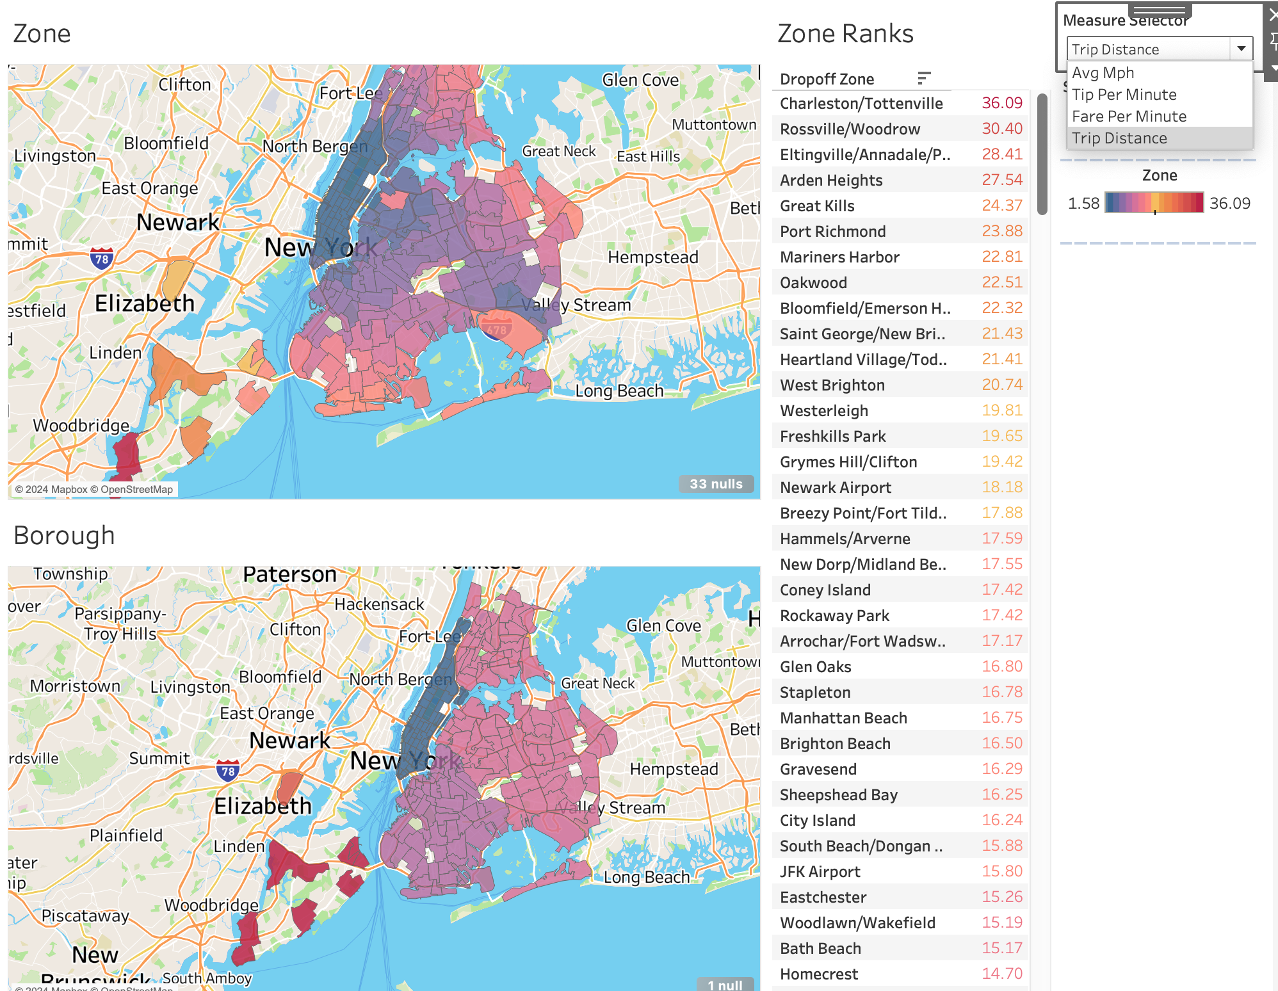
Notes:
Louie

Slide 39
References
[1] https://github.com/jupyter/jupyter.github.io/blob/main/assets/share.png
[2] https://www.mysql.com/about/legal/logos.html
[3] https://quintagroup.com/cms/python/images/sqlalchemy-logo.png/view
[4] https://www.tableau.com/about/media-kit
[5] https://www.snoqap.com/posts/2023/5/21/the-economic-impact-of-ride-hailing-apps-on-the-taxi-industry

